Slide 1
Discrete Mathematics
Spring 2020
Yuan Ze University

Slide 2
Representing graphs

Slide 3
Adjacency list representation
1: 2 ■
2: 1, 3, 4 ■
3: 2, 4 ■
4: 2, 3 ■
5: ■
1
2
5
4
3

Slide 4
Adjacency matrix
1
2
5
 | 1 | 2 | 3 | 4 | 5
1 | 0 | 1 | 0 | 0 | 0
2 | 1 | 0 | 1 | 1 | 0
3 | 0 | 1 | 0 | 1 | 0
4 | 0 | 1 | 1 | 0 | 0
5 | 0 | 0 | 0 | 0 | 0
4
3

Slide 5
Our default choice
Adjacency list representation

Slide 6
Depth-first search (DFS)

Slide 7
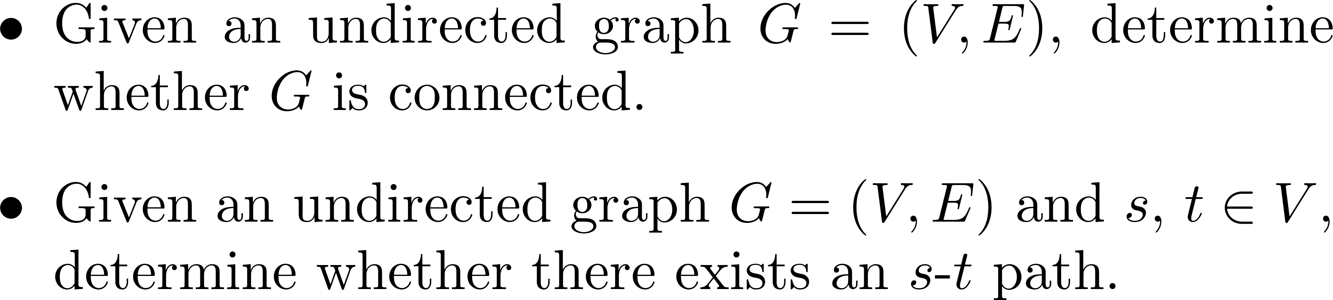
Our problems

Slide 8
The depth-first search

Slide 9
What does the turtle do?
Whenever there is a neighbor not yet traversed, traverse it.
Go back when all the neighbors are traversed.

Slide 10
烏龜心法
只要旁邊還有一個沒走過的點，就走過去
只要旁邊每個點都走過了，就回頭

Slide 11
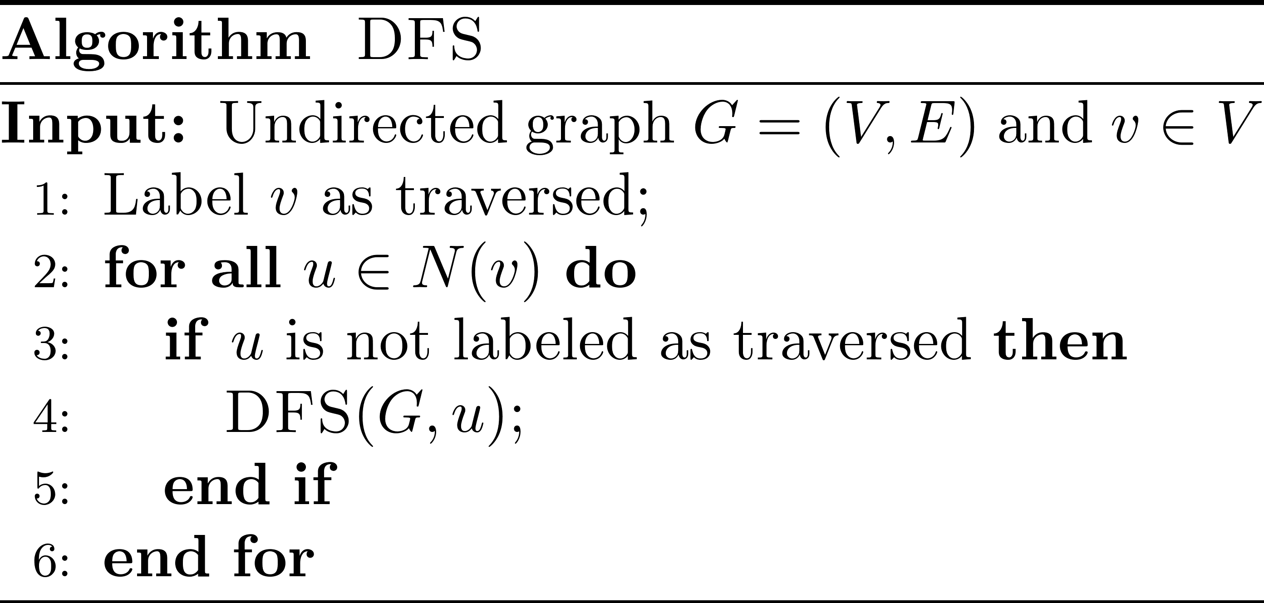
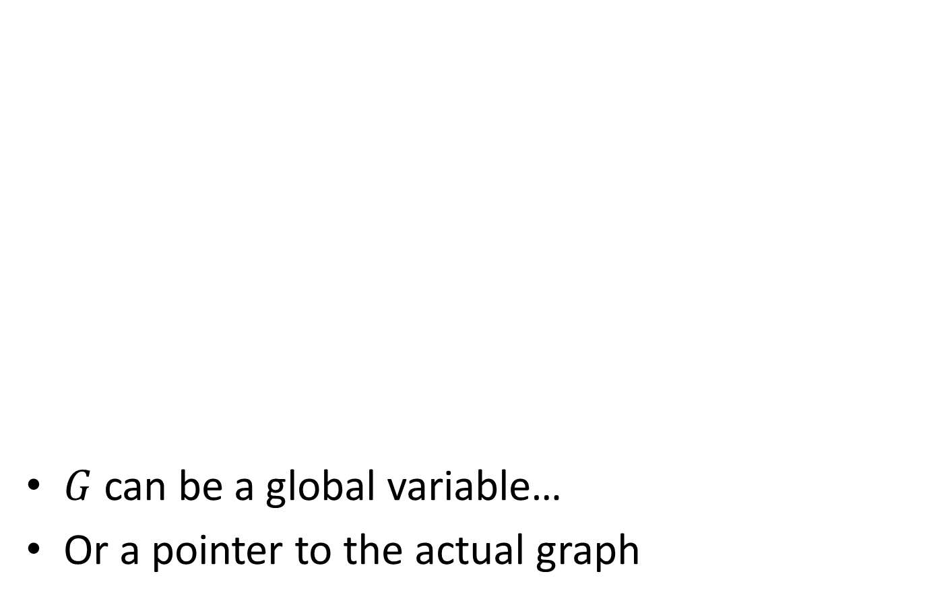
Pseudocode
$G$ can be a global variable…
Or a pointer to the actual graph

Slide 12








Function calls ☺
3
6
2
5
4
7
1

Slide 13
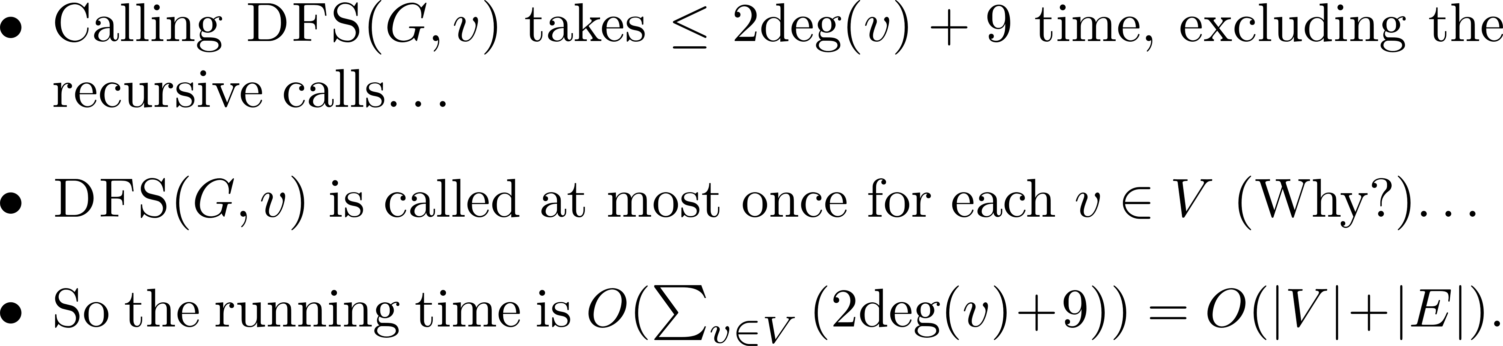
Running time ☺

Slide 14
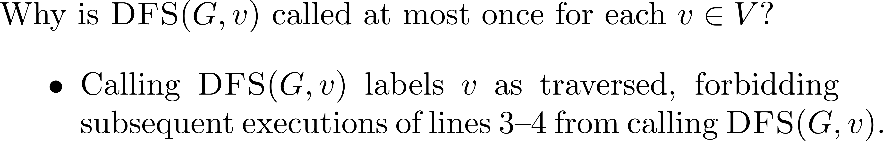
A short explanation… ☺

Slide 15
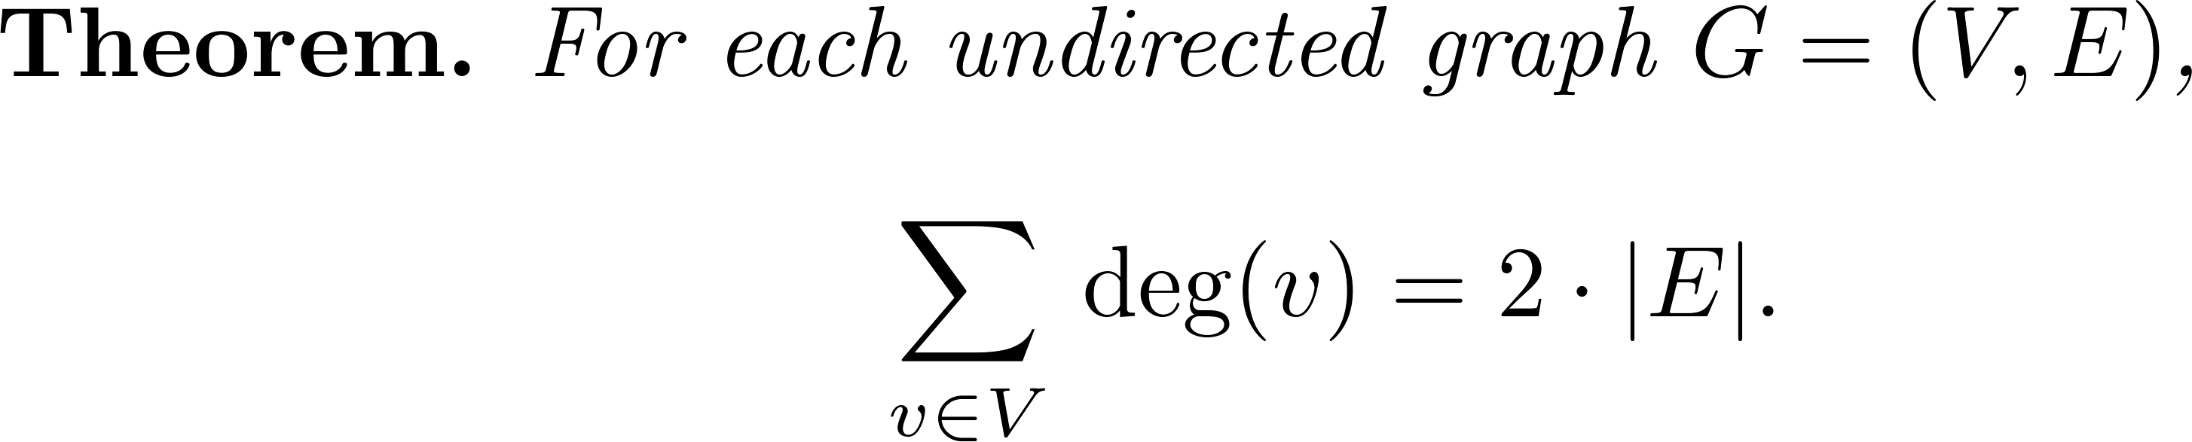
The handshaking lemma

Slide 16
So…

Slide 17
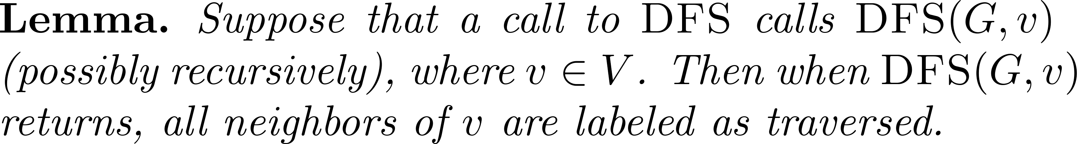
Which vertices are traversed?

Slide 18
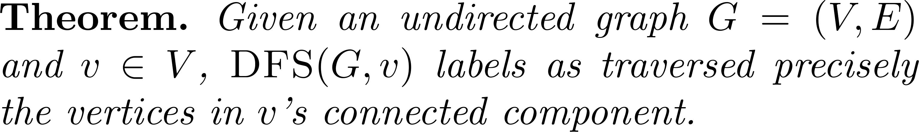
Which vertices are traversed?

Slide 19
All solved!

Slide 20
DFS tree

Slide 21
The traversed forms a tree

Slide 22

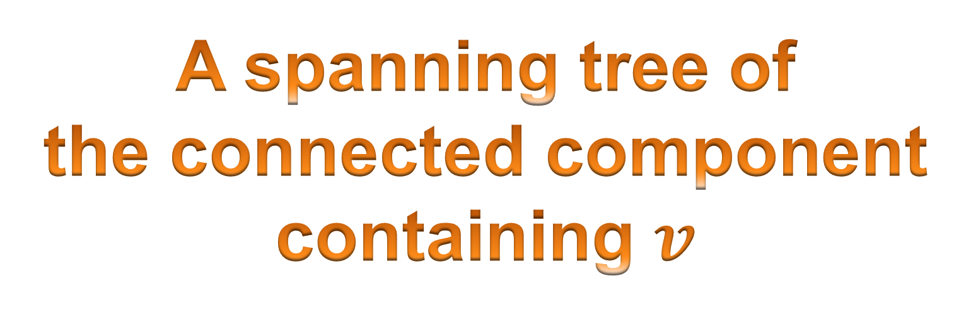
By-product: A spanning tree
A spanning tree of
the connected component
containing $v$

Slide 23
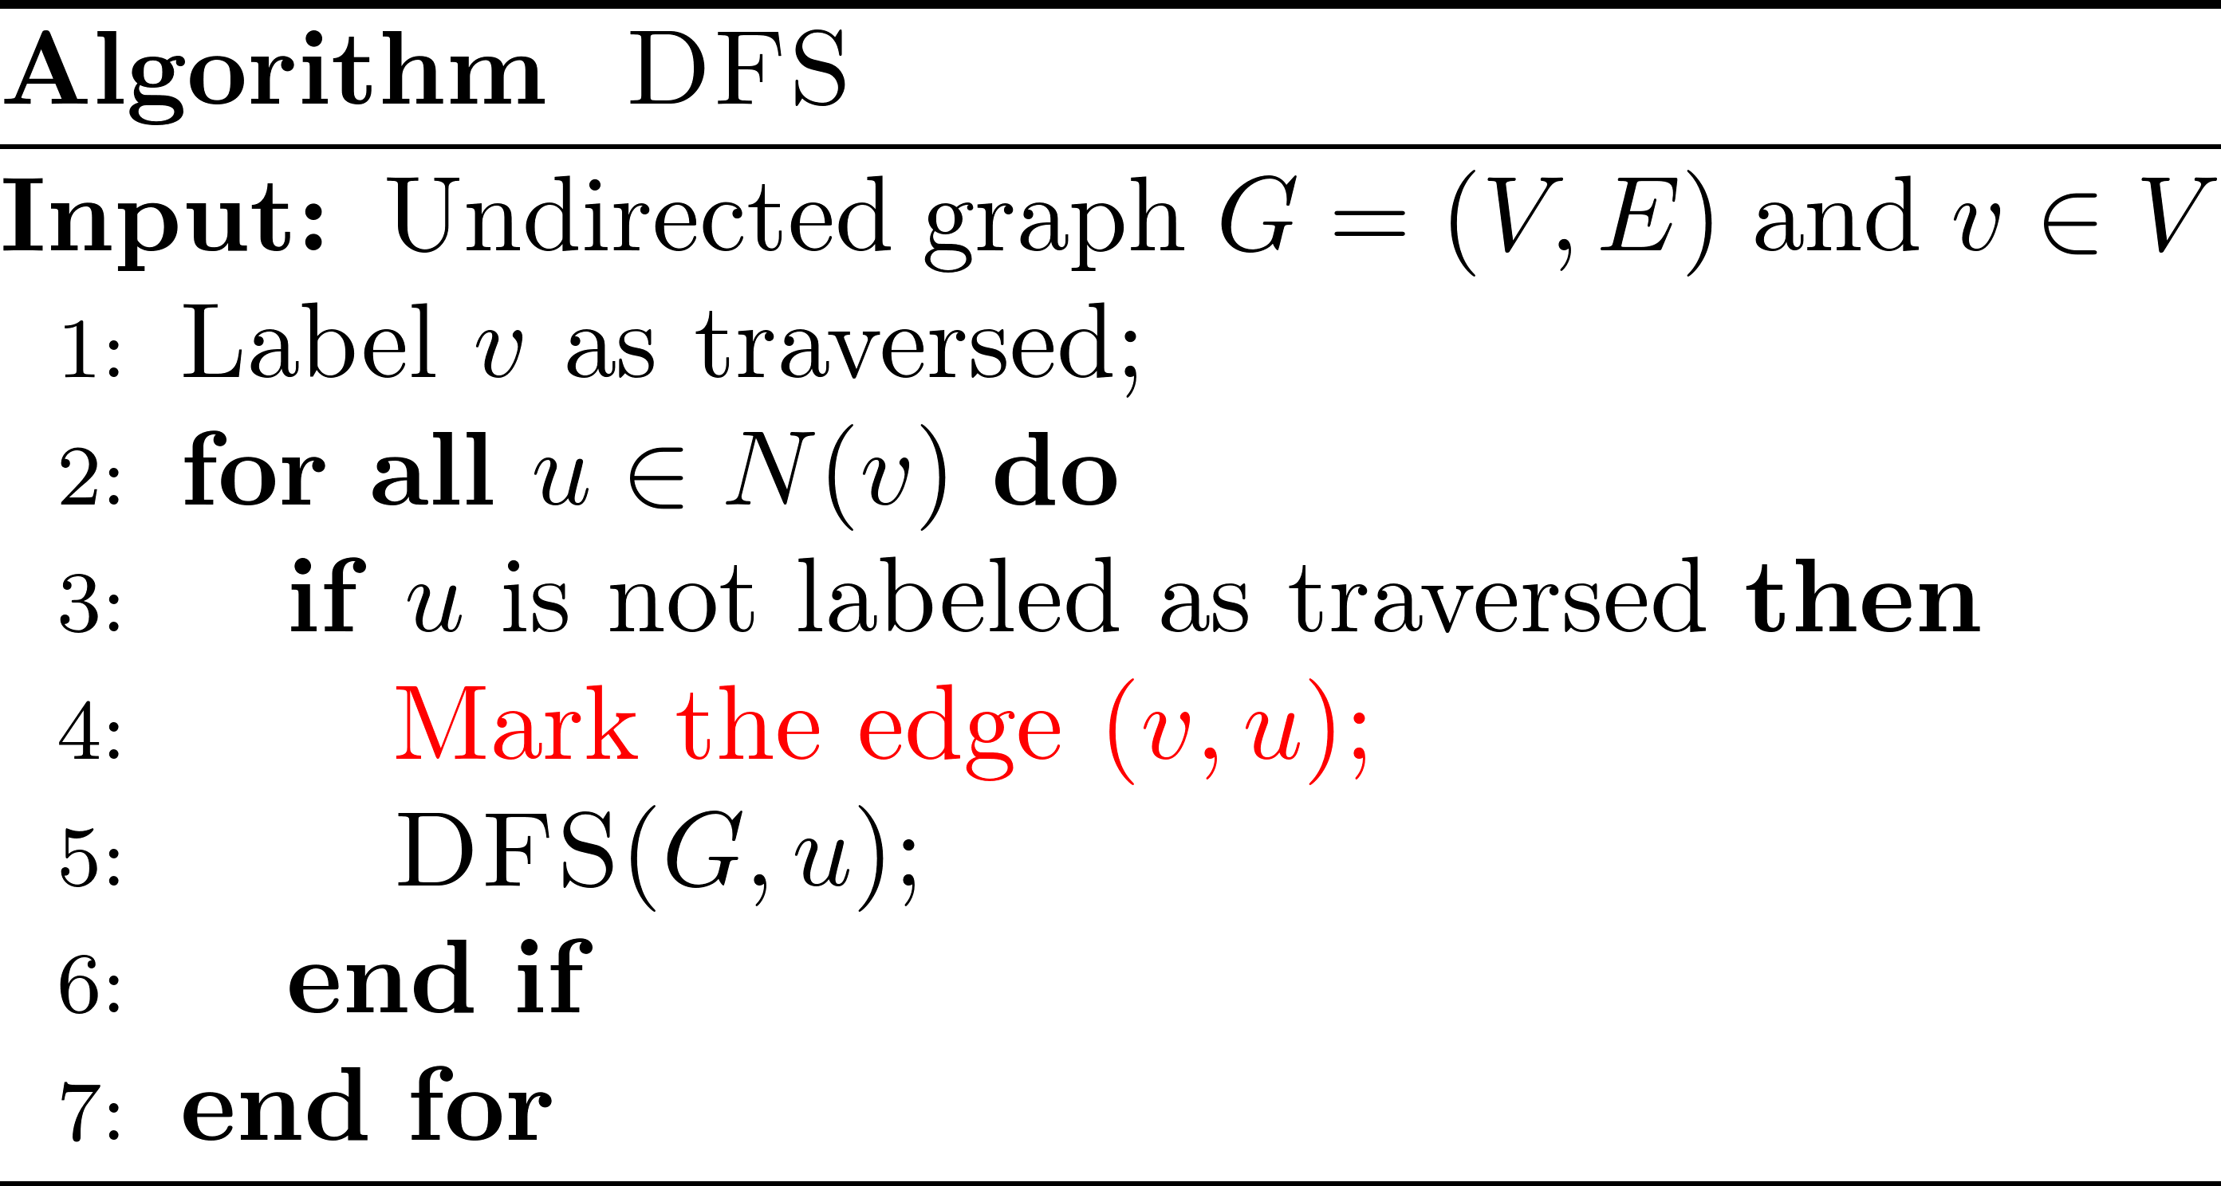
Marking the traversed edges

Slide 24
Theorem
At the end of the depth-first search, the traversed vertices together with the marked edges form a tree (i.e., a connected acyclic graph).
The next slide illustrates this.

Slide 25
Growing a tree
traversed
traversed

Slide 26
No cross edges!

Slide 27


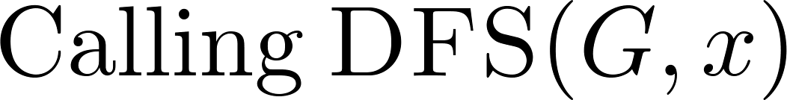
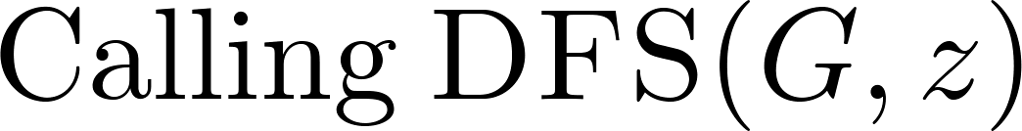









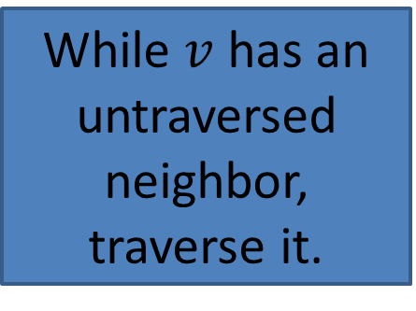
Illustration ☺
While $v$ has an untraversed neighbor, traverse it.

Slide 28
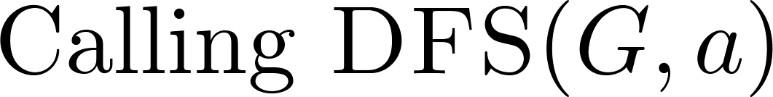



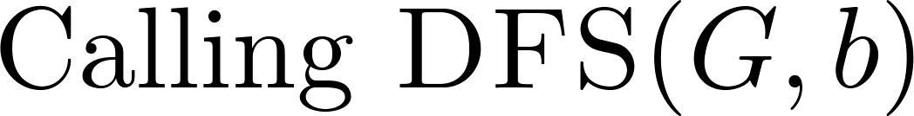

The order of function calls ☺

Slide 29
A recap

Slide 30
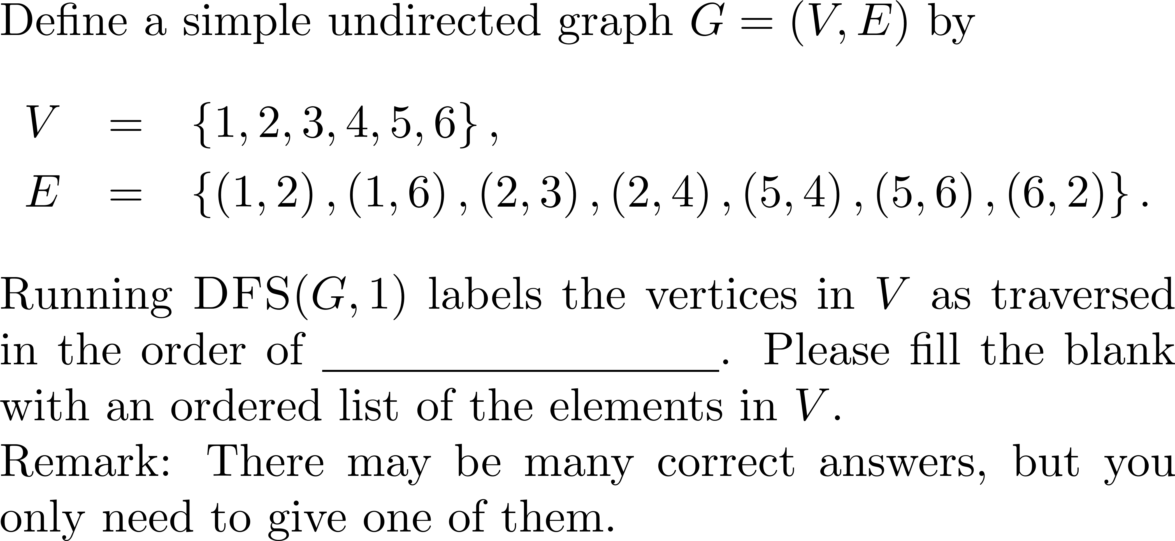
Quiz

Slide 31
A question
Can we save lots of space, while possibly wasting time, in determining whether a graph is connected?

Slide 32
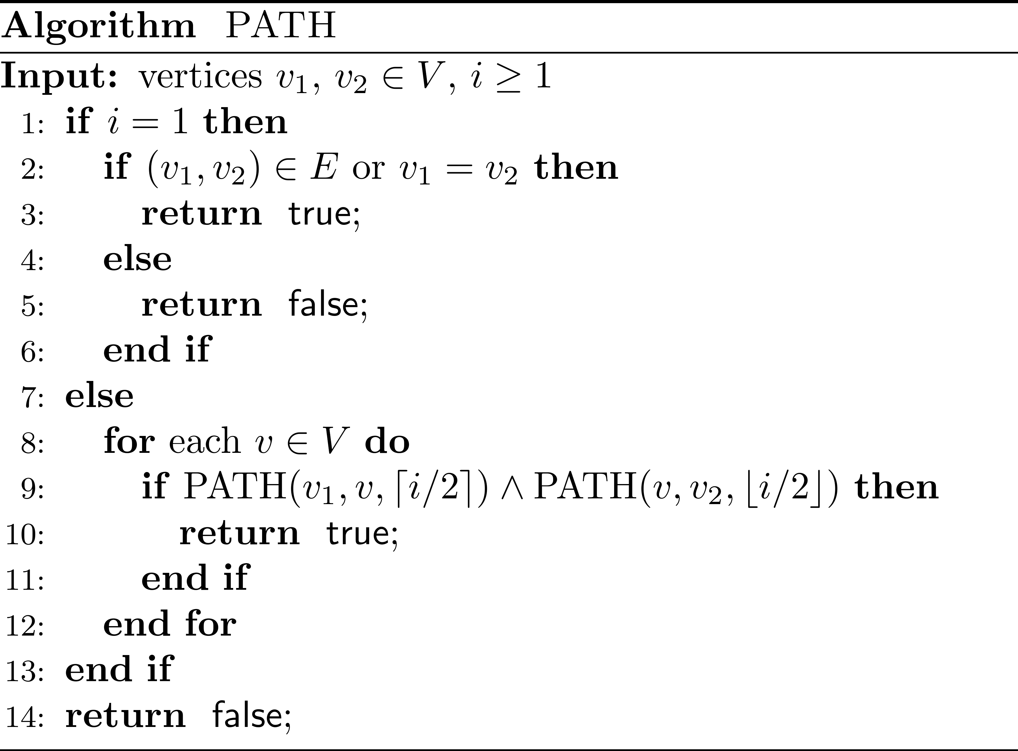

Slide 33
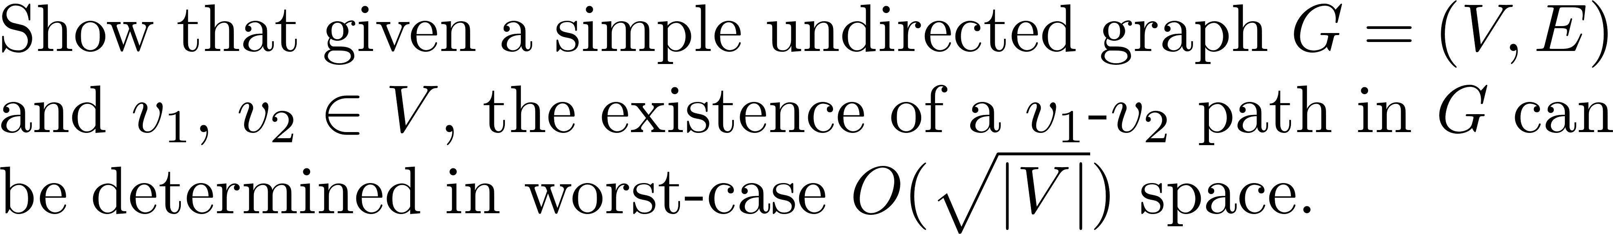
Quiz
Hint: See the previous page

Slide 34
Comments?

